Slide 1
Microsoft Power Platform
Notes:
Hi, Welcome to Microsoft Power Platform + Dynamics 365 Bootcamp.

Slide 2
Course Overview
Day 1 – Part I
Empowering Everyone with Power Platform – From CEO to Frontline Workers
Introduction to Power Platform
Day 1 – Part II
Power Packed Day with Power Canvas Apps
Introduction to Power Apps
Day 2 – Part I
Power Packed Day with Power Model Driven Apps
Let’s talk about data
Day 2 – Part II
Power Packed Day with Power Automate
Introduction
Microsoft Power Platform momentum
Why Power Platform?
Customer Stories
Demo
Benefits of Power Apps
What can I build with Power Apps?
Types of Power Apps
Canvas Apps
Data Sources and Connectors
Demo
Types of Data
Dataverse
Model-driven Apps
What type of components can I add?
Data model design
Demo
Types of flow
Data types and expression
Working with Arrays
Control flow and action settings
Demo

Slide 3
Continue…
Day 3 – Part I
Power Packed Day with Power Agents
Day 3 – Part II
Power Packed Day with Power BI
Day 4 – Part I
Power up your Apps with AI Builder
Day 4 – Part II
Power Platform Administration, Security & Integration Connectors
Introduction
A Robust Virtual Agent Platform
Converse everywhere
Easily make your bots better
Create personalized customer experiences
Transfer to a human agent
Built on Power Platform & Azure Bot Service
Extend your bot capabilities with Azure Bot Service
Demo
Introduction
The 5x5 Principle
Customer momentum: Power BI
Power BI Desktop
Data sources
Power Query
Dataflow
Paginated Reporting
Power BI Admin Portal
Demo
Introduction
AI for every app. And everyone
Setup Environment
Types of AI Model
Prediction
Form processing
Object detection
Text classification
Demo
Introduction
Secure your tenant
Monitor your tenant’s activity
Alert & act on that activity
Connectors
SharePoint Integration
Demo

Slide 4
Day 2: Power Packed Day with Power Model Driven Apps – Part I

Slide 5

Agenda
Let’s talk about data
Data→ Connectors→ Data Verse
Types of Data
Data Verse
Model-driven Apps
What type of components can I add?
Data model design
Demo

Slide 6




Let’s talk about data
Analyze
Power BI
Know
Act
Automate
Power Apps
Automate
AI Builder
Learn

Slide 7
Let’s talk about data
Analyze
Power BI
Know
Act
Automate
Power Apps
Automate
Connectors
AI Builder
Learn

Slide 8

Let’s talk about data
Analyze
Power BI
Know
Act
Automate
Power Apps
Automate
CDS
AI Builder
Learn

Slide 9

Two Types of Data. . .
External
Internal

Slide 10
Two Types of Data. . .
Connectors
Common Data Service

Slide 11
Oh, the apps you can build. . .
Client | Connectors | Common Data Service (Data Verse)
Power Apps (Canvas) | Yes | Yes
Power Apps (Model) | No | Yes
Power Portals | No | Yes
Power Automate | Yes | Yes
AI Builder | No | Yes
Power BI | Yes | Yes

Slide 12
Why external data (Connectors)?
It’s easy
It’s home

Slide 13

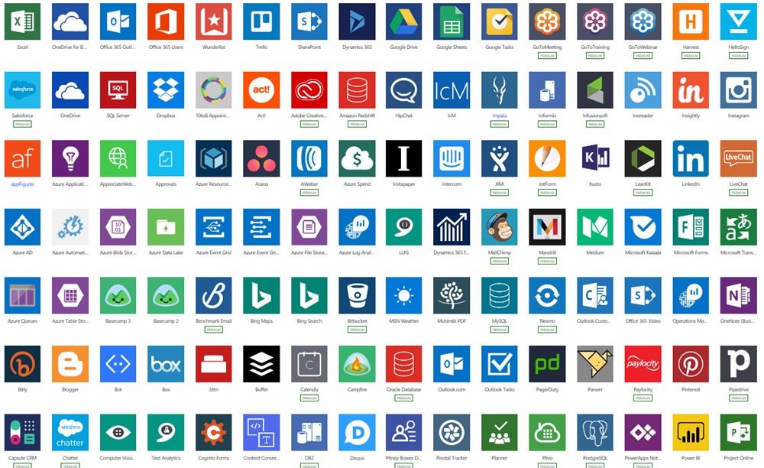
Why external data (Connectors)?
Built-in connectivity to 487+ cloud services, content services, databases, APIs, etc.
Seamless hybrid connectivity to on-premises systems via the on-premises data gateway.
Develop and register custom connectors as a building block for citizen developers.
Connect data silos by using multiple data sources in a single application.

Slide 14
Why internal data (Common Data Service)?
It’s smart
It scales
It’s secure

Slide 15
Create a model-driven application in Power Apps

Slide 16
Introduction to Microsoft Dataverse
Foundational data source of Microsoft Power Platform
Data is stored in tables
Benefits:
Simple to manage
Helps secure your data
Access your Dynamics 365 data
Rich metadata
Logic and validation
Productivity tools

Slide 17
Introduction to model-driven apps
Component-focused approach
Benefits:
Rich component-focused, no-code design environments
An ability to create complex responsive apps with a similar UI across a variety of devices from desktop to mobile
Robust design capability
Apps can be distributed as a solution

Slide 18
Microsoft Dataverse and model-driven apps
Tables from Microsoft Dataverse as your building blocks
Modeling business data
Defining business processes
Composing the app

Slide 19
Create tables in Dataverse

Slide 20
Table characteristics
When to use standard / custom tables
Table relationships
One-to-many relationships (1:N)
Many-to-many relationships (N:N)
N:1 => 1:N
Table owners
User or team owned
Organization-owned
Business Rules

Slide 21
Create a custom table and import data

Slide 22
Model-driven apps in Power Apps

Slide 23
Design Phases
Model your business data
Define your business processes
Build the app

Slide 24
Building blocks
Data
Table
Column
Relationship
Choice column
Logic
Business process flow
Workflow
Actions
Business rule
Flows
User Interface
App
Site map
Form
View
Visualization
Chart
Dashboard
Embedded Microsoft Power BI

Slide 25
Create a model-driven app

Slide 26
Control security when sharing model-driven apps
Create a custom security role.
Assign users to the custom security role.
Assign the security role to an app.

Slide 27
Thank you

